Slide 1
AISC 2010 Final Presentation
Group I
Asitkumar Patel(500211508)
Meeraben Gangani(500210808)
Akil Khoja(500209564)
Shivaganesh Birru(500211953)

Slide 2
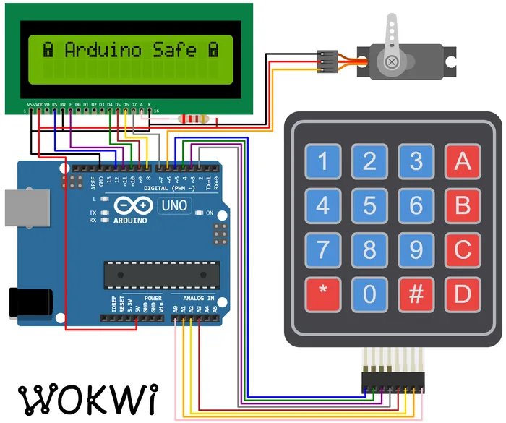
Introduction
The finance and banking sector, guardians of invaluable assets, currently relies on traditional lock-and-key mechanisms and basic electronic keypads for safeguarding assets in electric safe boxes.
The primary problem with the SOTA lies in its inability to adapt to modern security standards and the increasing sophistication of intrusion techniques.

Slide 3
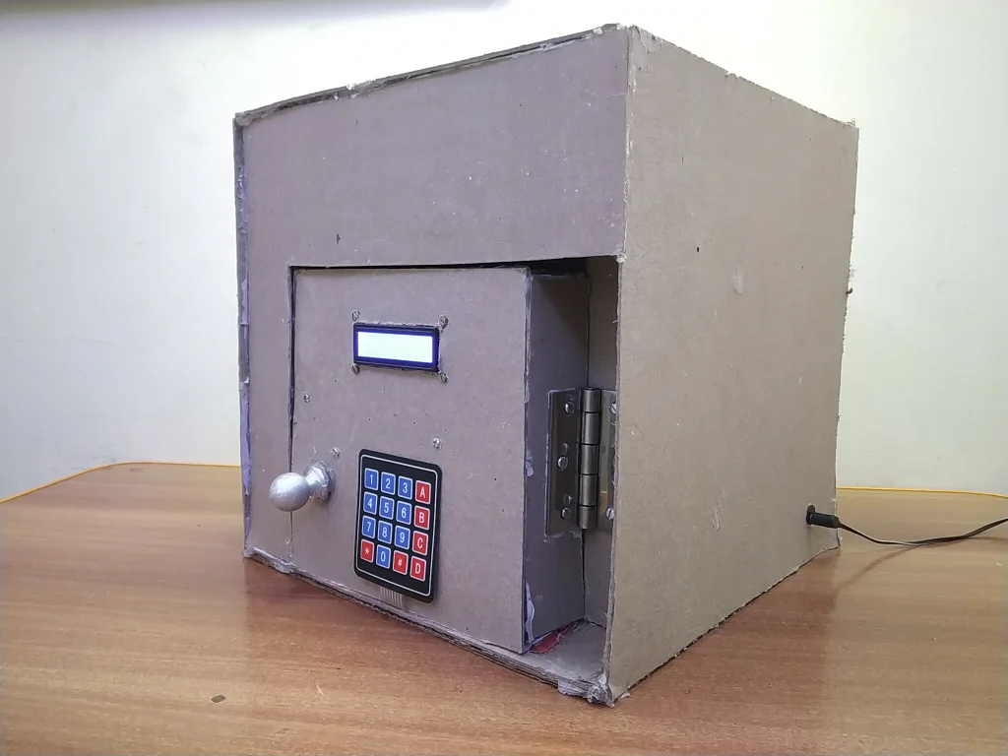
Overview of the project
Content Overview:
Designing
Material Gathering
aking the Box
Electronics
Coding
Door
Door Frame
Finishing
Conclusion

Slide 4
Overcoming Technical Challenges
Secure Code Handling:
Secret code stored in EEPROM for secure, non-volatile memory.
Additional encryption layers for heightened security.
Servo Motor Precision:
Rigorous calibration routines ensure precise control.
Robust error-checking mechanisms to prevent mechanical failures.
User Interface Excellence:
Intuitive keypad design for seamless user experience.
Continuous user testing and feedback integration for refinement.
Future-Proof Design:
Modular firmware architecture allows for upgrades.
Anticipates and adapts to emerging security standards.

Slide 5
Innovative Solution - Servo-Driven Electric Safe Box
Secure Code Handling:
Implementation: Utilize EEPROM for secure, persistent storage.
Enhancement: Introduce additional encryption layers for heightened security.
Servo Motor Precision:
Strategy: Implement regular calibration routines for precise control.
Safety Measures: Incorporate robust error-checking mechanisms to prevent mechanical failures.
User Interface Excellence:
Design Philosophy: Develop an intuitive keypad for a seamless user experience.
Continuous Improvement: Integrate continuous user testing and feedback for ongoing refinement.
Future-Proof Design:
Modular Architecture: Adopt a modular firmware architecture for seamless upgrades.
Adaptability: Anticipate and adapt to emerging security standards for long-term viability.

Slide 6
Future Vision
Biometric Integration:
Explore advanced biometric authentication for heightened security.
Remote Monitoring:
Implement capabilities for remote monitoring of safe box status.
Smart Home Integration:
Integrate with smart home security systems for seamless connectivity.
Enhanced Connectivity:
Establish greater connectivity options to adapt to evolving technologies.
Interoperability:
Aim for seamless integration with emerging financial technologies.

Slide 7
Collaboration and Development
GitHub Repository:
https://github.com/Asitsp/IOT
Trello Board:
https://trello.com/b/GrhYOAql/aisc2010final

Slide 8
References
https://www.instructables.com/Arduino-Based-Digital-SAFE-BOX/
https://wokwi.com/projects/344891391763022419
https://trello.com/b/GrhYOAql/aisc2010final

Slide 9
Thank you
Q & A

